Slide 1

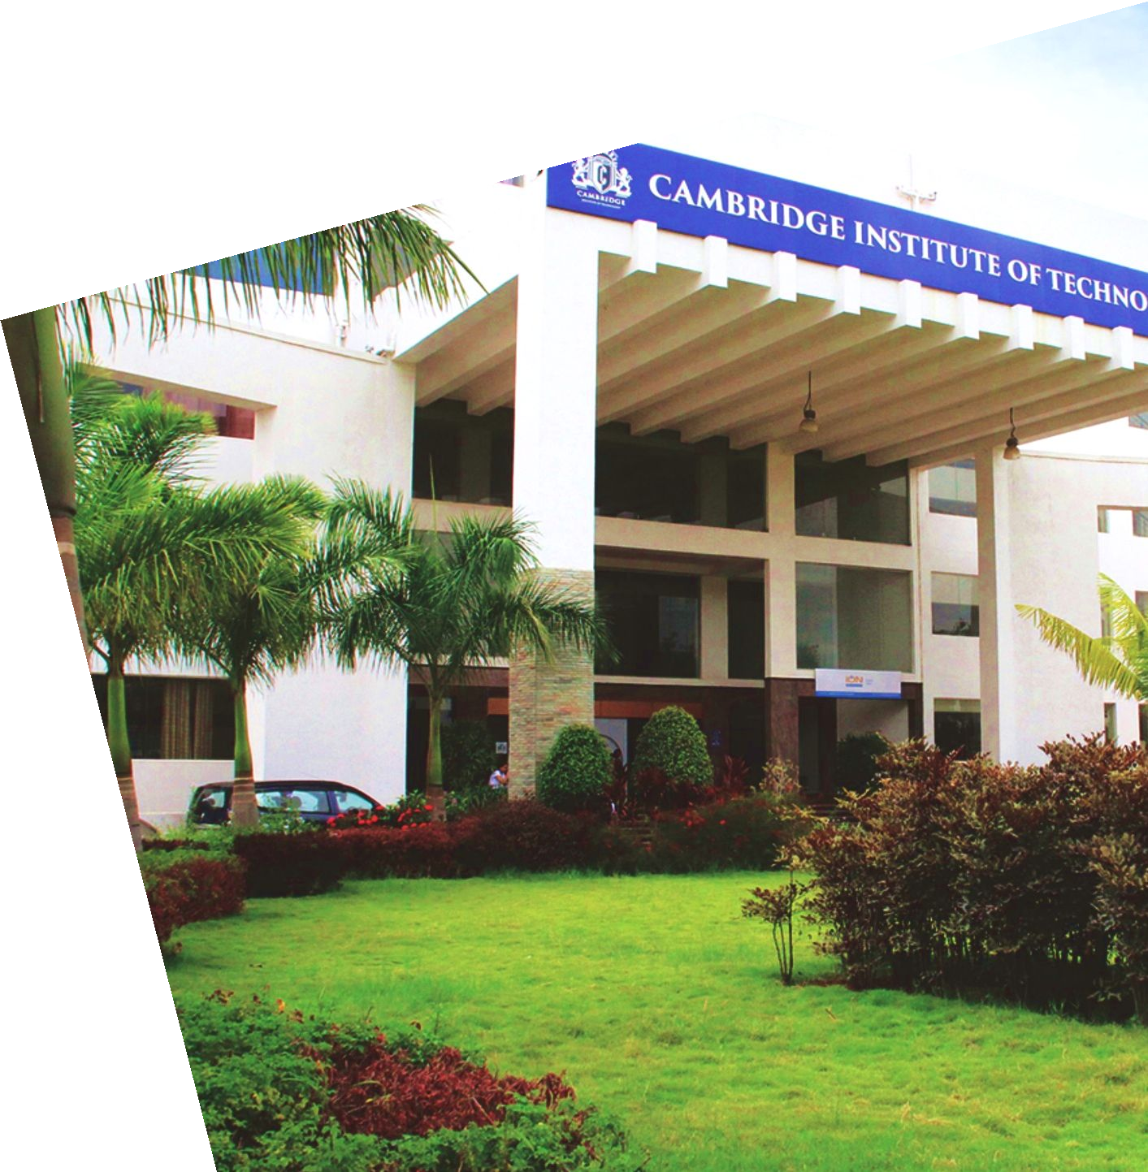
“DermaLens: A fairness-Aware, Explainable smartphone Application for Early Skin Cancer Risk Assessment”
Phase-1 Project Presentation
On
By
V Dhanush
Sanjana T G Vasudha
1CD23IS181 1CD23IS145 1CD23IS186
Under the Guidance of
Dr.Priyanka Desai
Professor
Department of
INFORMATION SCIENCE AND ENGINEERING www.cambridge.edu.in

Slide 2
Content
Title of the Project
Proposed Method
Objectives
Motivation
Challenges
Applications

Slide 3
Title Of the Project
DermaLens
A Fairness-Aware, Explainable Smartphone Application for
Early Skin Cancer Risk Assessment

Slide 4
Proposed Method
Architecture — FairDermNet
Backbone: MobileNetV3-Large (pretrained on ImageNet) — lightweight yet accurate, well-suited for mobile deployment.
FairnessAttentionModule (FAM): A skin-tone-conditioned attention module inserted after the backbone. Given a predicted Fitzpatrick group, FAM re-weights intermediate feature maps to reduce representation disparity between light and dark skin tones.
Generalised Mean Pooling (GeM): Replaces the standard global average pooling with a learnable GeM pooling layer, producing richer feature descriptors for fine-grained lesion discrimination.
9-Class Head: A fully-connected classification head with softmax output over MEL / BCC / SCC / AK / BOD / NV / BKL / DF / VASC.
Training Configuration
Datasets: HAM10000 (~10k dermoscopic) + ISIC 2019 (~25k dermoscopic) + PAD-UFES-20 (~2.3k smartphone), total ~37k training images.
Loss Function: Composite loss = α·CrossEntropy + β·FairnessLoss + γ·DiversityLoss (α=1.0, β=0.15, γ=0.25).
Hardware & Efficiency: RTX 3050 Laptop (6 GB VRAM), batch size 16, gradient accumulation ×4 (effective batch=64), AMP fp16 mixed precision, 30 epochs.
Fairness Evaluation: DDI Stanford dataset (held-out, 656 images) used exclusively for post-training fairness audit across skin-tone codes 12 / 34 / 56.
Export Pipeline: Best checkpoint → TFLite INT8 quantisation → Flutter app integration for on-device inference.
Explainability Pipeline
After classification, Grad-CAM heatmaps are overlaid on the input image to indicate the lesion region contributing most to the decision. SHAP values are computed for feature-level attribution. Both outputs are surfaced in the Flutter app alongside the class probability distribution, giving the user and clinician a transparent view of model reasoning.

Slide 5
Objectives
Primary Objectives
Multi-Class Classification: Build a model that classifies dermoscopic and smartphone images into 9 lesion categories — MEL, BCC, SCC, AK, BOD, NV, BKL, DF, VASC — using combined HAM10000, ISIC 2019, and PAD-UFES-20 datasets (~37k images).
Fairness-Aware Training: Integrate skin-tone fairness loss (α=1.0, β=0.15, γ=0.25) via a FairnessAttentionModule so the model performs equitably across Fitzpatrick skin-tone groups I–VI, evaluated on the held-out DDI Stanford dataset (656 images, tone codes 12/34/56).
Explainability: Generate per-prediction visual explanations (Grad-CAM / SHAP overlays) to highlight the lesion regions driving the model's decision, improving clinical trust.
Mobile Deployment: Export the trained model to TFLite INT8 format for integration into a cross-platform Flutter application, enabling on-device inference without cloud dependency.
Secondary Objectives
Achieve balanced per-class accuracy across all 9 categories, addressing severe class imbalance through weighted sampling and augmentation.
Maintain efficient inference (≤500 ms per image) on a mid-range Android device using the quantised TFLite model.
Conduct threshold analysis (Cell 9c) to identify optimal per-class decision thresholds that maximise sensitivity for high-risk malignant classes (MEL, BCC, SCC).
Evaluate fairness metrics (equalized odds, demographic parity) across skin-tone groups and compare before/after fairness-loss regularisation.

Slide 6
Motivation
Skin cancer is the most prevalent cancer globally, yet early-stage detection remains alarmingly low in resource-constrained and diverse-population settings. Existing AI-based dermatology tools present two critical gaps:
Bias Against Darker Skin Tones: Most benchmark datasets (HAM10000, ISIC) are dominated by Fitzpatrick I–III images (lighter skin), causing models to underperform on Fitzpatrick IV–VI patients — a population that is simultaneously under-screened and underrepresented.
Black-Box Decisions: Clinicians and patients distrust deep learning models that produce a diagnosis label without explanation, making clinical adoption difficult.
Limited Access: High-cost dermatoscopy hardware is unavailable to many patients; a smartphone-based solution is needed.
Multi-Class Insufficiency: Most deployed tools cover only 2–3 lesion types, whereas real-world diagnosis requires distinguishing at least 9 clinically relevant classes.
DermaLens is motivated by the need for an accurate, fair, explainable, and accessible skin lesion classifier — one that performs equitably across all skin tones and can be deployed on a mobile device without a specialist hardware requirement

Slide 7
Challenges
Data Challenges
Severe Class Imbalance: NV (nevi) accounts for >60% of HAM10000, while VASC and DF each represent <2%, making naive training heavily biased toward benign lesions.
Skin-Tone Underrepresentation: HAM10000 and ISIC 2019 lack ground-truth Fitzpatrick labels; skin-tone estimation must be inferred, introducing label noise.
Domain Shift: PAD-UFES-20 uses smartphone cameras rather than dermatoscopes, creating a significant image quality and capture-condition gap relative to HAM10000/ISIC.
Label Taxonomy Alignment: Merging three datasets with differing label schemas required constructing a unified 9-class taxonomy and handling inter-dataset label ambiguities.
Modelling Challenges
Accuracy-Fairness Trade-off: Minimising overall cross-entropy can actually worsen per-group fairness. Balancing α, β, γ in the composite loss without degrading overall AUC is non-trivial.
VRAM Constraints: The 6 GB RTX 3050 limits batch size; gradient accumulation partially compensates but introduces training instability if not carefully tuned.
CUDA Compatibility: Environment-specific CUDA/PyTorch mismatches required targeted hotfixes to enable GPU-accelerated training in the project's conda environment.
Quantisation Quality Drop: INT8 quantisation for TFLite export can degrade model accuracy, especially for minority classes; per-class threshold recalibration post-quantisation is required
Deployment Challenges
On-Device Latency: Ensuring inference completes within 500 ms on a mid-range Android device while rendering Grad-CAM overlays requires careful model profiling and potential post-processing optimisation.
Regulatory & Ethical Considerations: Skin cancer detection is a safety-critical application; communicating confidence scores and uncertainty to non-specialist users without encouraging self-diagnosis is a key UX challenge.

Slide 8
Applications
Research & Academic Applications
Benchmark for Fairness-Aware Dermoscopy Models: DermaLens provides a reproducible training pipeline, multi-dataset taxonomy, and fairness loss formulation that other researchers can build upon.
Generalisation to Other Skin Conditions: The FairDermNet architecture is generalisable to eczema, psoriasis, or pigmentation disorder classification tasks with minimal retraining.
XAI in Medical Imaging: The combined Grad-CAM + SHAP explainability module serves as a transferable template for other medical image classification tasks (retinal disease, histopathology, etc.).
Public Health & Awareness
Population Screening Campaigns: Can be deployed as a free mobile app in large-scale skin cancer awareness campaigns, enabling self-screening at scale.
Health Equity Research: The fairness audit pipeline (DDI Stanford evaluation) contributes a replicable methodology for measuring and reporting AI health equity metrics in dermoscopy models.
Clinical & Healthcare Applications
Triage Support Tool: Assists general practitioners and nursing staff in primary care settings to flag suspicious lesions for urgent dermatology referral, reducing diagnostic bottlenecks.
Teledermatology: Enables remote dermatology consultations in rural or underserved areas where specialist access is limited — a patient captures a smartphone image; the app provides an instant preliminary classification.
Clinician Decision Support: Provides Grad-CAM-annotated images during consultations to direct the clinician's visual attention to the most diagnostically relevant lesion features.
Industry & Commercial Applications
Integration with Wearables: The lightweight TFLite model can be ported to smartwatches or IoT skin sensors for continuous lesion monitoring.
Hospital Information System (HIS) Plugin: The model can be packaged as a REST API microservice, enabling plug-in integration with hospital PACS and EHR systems.
Pharmaceutical & Cosmetic Skin Analysis: Adaptable for skin condition tracking in clinical trials for dermatological drug products.

Slide 9
Thank you

